Slide 1



SUPPLY CHAIN
Empowering Supply Chains with Insightful Analytics
Supervisor
Dr. Sara Abdelghafar
Supervisor
Group No.
Eng Eman Ghanem
1

Slide 2

Team Members
project overview
Data source
Modeling overview
Analysis and insight
Dashboard Demo
Conclusion

Slide 3


Slide 4

Project Overview
This project analyzes a comprehensive Supply Chain dataset to extract valuable insights into key areas such as logistics, inventory management, procurement, and supplier performance. By applying descriptive statistics, trend analysis, and predictive modeling, it identifies inefficiencies, forecasts disruptions, and optimizes supply chain operations. The analysis supports informed decision-making and risk management strategies, helping organizations enhance efficiency and resilience. Interactive visualizations, including Power BI and Tabluea dashboards, are used to present insights clearly, enabling stakeholders to make data-driven decisions and improve overall supply chain performance.

Slide 5
Data source
The project utilizes a rich supply chain dataset covering order timelines, shipping accuracy, and fulfillment metrics to uncover insights on delivery performance and logistics efficiency. The dataset consists of over 180,000 rows and 53 columns, providing comprehensive information on orders, shipping schedules, delivery status, costs, and product details. The data was sourced from Google Dataset Search, ensuring high reliability and relevance for logistics analysis.
Data set

Slide 6
Modeling Overview
1.Raw Data Challenges
The initial dataset was a large CSV file containing 180,000 rows and 56 columns. There were numerous duplicates, which were impacting performance significantly. These redundant records increased the file size unnecessarily and caused inefficiencies in processing and analysis. To improve the situation, duplicate entries were identified and removed, resulting in better performance and a more streamlined dataset for analysis

Slide 7
Modeling Overview
2.Data Preparation:
In the Data Preparation phase, I focused on making the data ready for analysis through the following steps:
Removing Irrelevant Columns: identified and removed columns that were not relevant to the analysis. This helped streamline the data and ensure that only the necessary information was retained.
Changing Data Formats: adjusted the format of each table to meet the analysis requirements. This included modifying data types to align with the necessary standards, ensuring compatibility and consistency across the model.
Standardizing Date Formats: ensured that all date fields were converted into a unified format, making it easier to work with time-based data and perform time-related analysis.

Slide 8
Modeling Overview
4.Normalization & Schema Design
a.Dividing the Flat Table into Fact and Dimension Tables:
Used Power Query to split the flat table into Fact and Dimension tables.
The Fact Table contains key transactional data such as quantities and sales.
The Dimension Tables store descriptive data such as products, orders, and customers.
b.Foreign Key Relationships:
I established appropriate foreign key relationships to link the Fact and Dimension tables.
To ensure a one-to-many relationship between the Fact and Dimension tables,
I removed duplicates from the primary key of each Dimension table.
This ensures data integrity and allows for clear relationships between different data entities.
c.Normalization and Hierarchy:
I focused on normalization to reduce redundancy and improve data organization.
I ensured a proper hierarchy between tables, such as organizing products into categories and suppliers into regions.

Slide 9
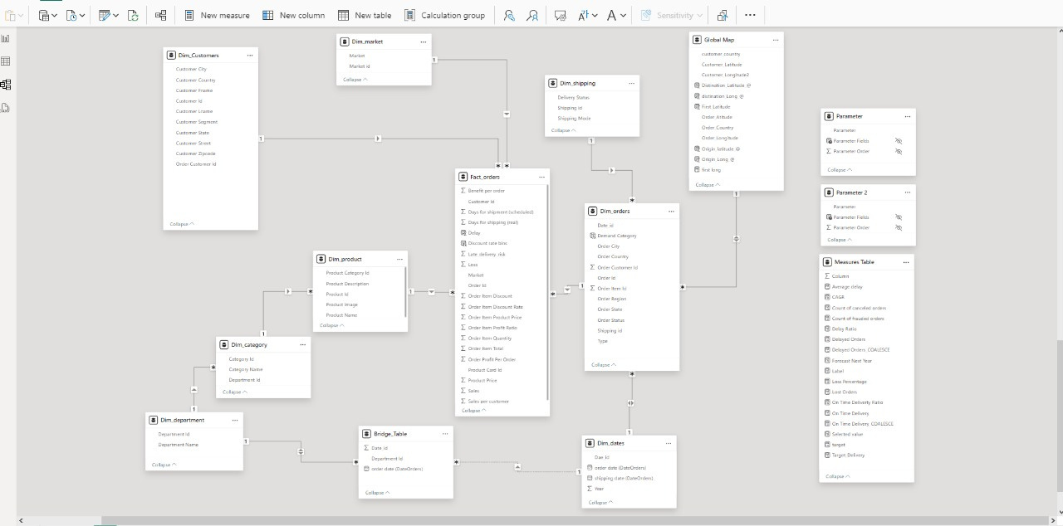
Modeling Overview
d.Snowflake Schema:
The normalization process resulted in a Snowflake Schema.
This structure reduces redundancy and improves query efficiency for better performance in Power BI.

Slide 10
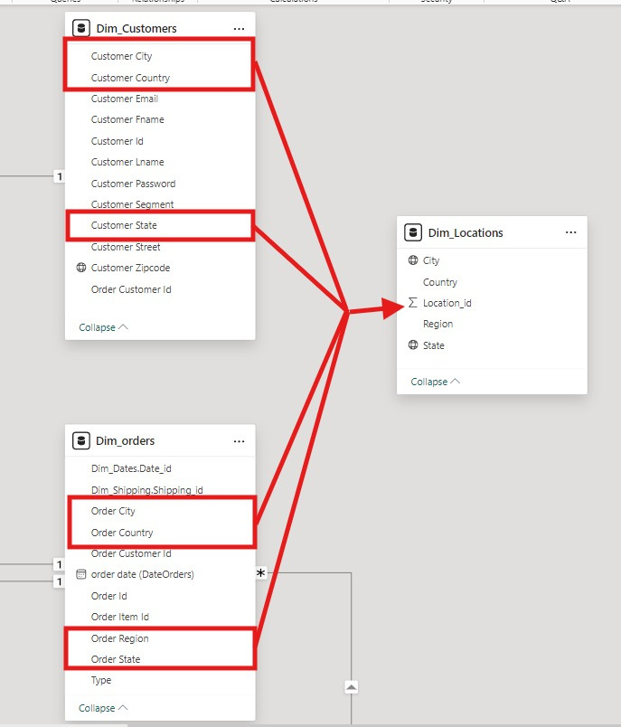
Modeling Overview
e.Creating Dim_Locations
The columns: (country, city, state) were repeated in both dimensions (Dim_Orders, Dim_Customers)
To reduce redundancy, I tried to merge them into new Dim table:
1.first standardized the column names across both tables
2.created a copy of the first table and performed a
union operation (Append query) with the second table to
ensure that the columns were added into the same table.
3.Remove duplicates from the entire table
4.Established an Index column to represent a unique identifier for each location.
5.Used merge query option (Left outer join) to integrate the location
id from Dim_locatoin into both Dim_orders and Dim_customers,
which ensure that every customer and order match
with the appropriate Location id
6.Deleted the unused columns (customer country, order country).
By doing so, I managed to minimize redundancy

Slide 11
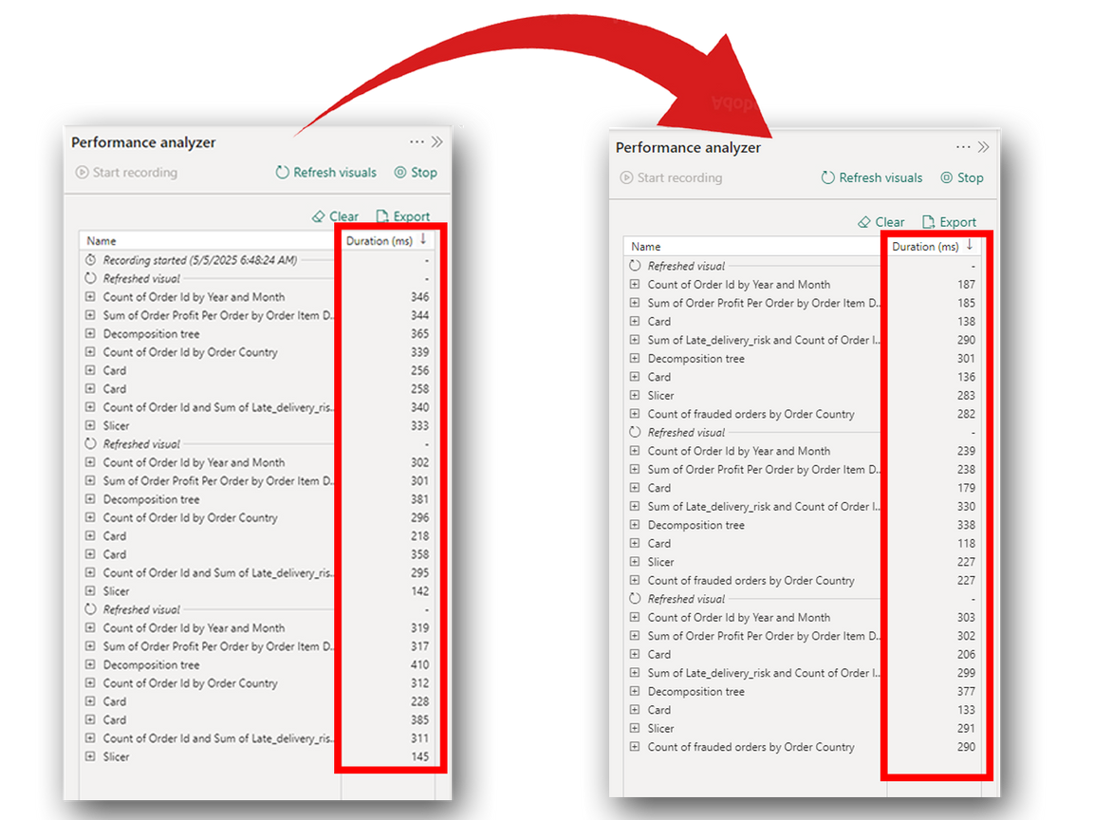
Modeling Overview
5.Performance And Optimization Analysis
After completing the modeling and transformation process,
I performed a performance analysis to notice the impact of
applying snowflake schema on the dataset.
The Performance Analyzer showed that:
Overall performance improved noticeably after applying
the Snowflake Schema.
This enhancement was primarily due to the removal of data
redundancy through normalization and the separation of the
flat table into well-structured Fact and Dimension tables.
By eliminating duplicate records and establishing proper
one-to-many relationships using foreign keys,
the model became more efficient and optimized for
filtering and slicing operations.
Compared to the flat table structure, the Snowflake Schema enabled faster query execution, smoother slicer interaction, and the duration required to load the data had slightly decreased because of the reduced data volume and complexity
Flat Table
Snowflake schema

Slide 12
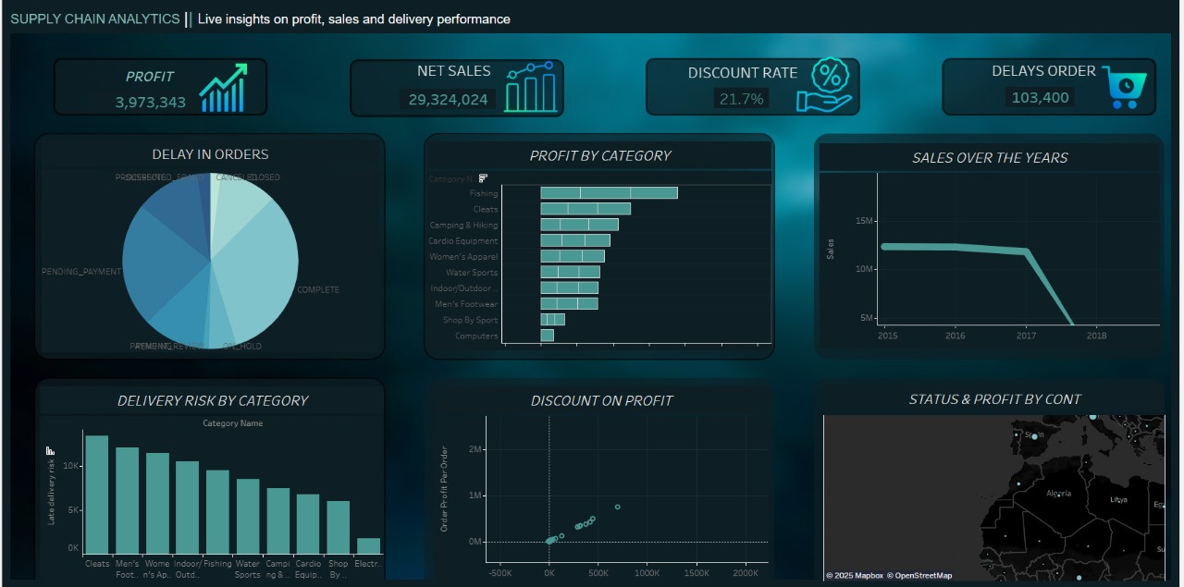
Analysis and insights

Slide 13
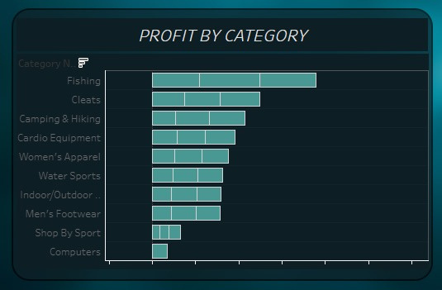
1.profit by category
The image illustrates the top 10 product categories by profit over the four years of 2015, 2016, 2017, and 2018. However, it’s noticeable that there are no recorded profits in 2018. Additionally, some products are being produced but are not generating any sales, which could lead to losses since they are manufactured but not sold.

Slide 14
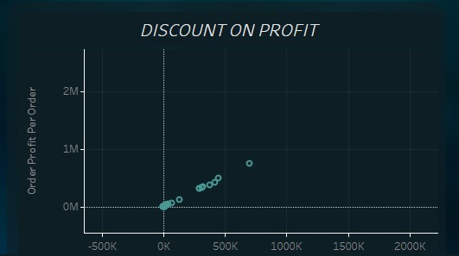
2.Discount on profit
The image measures the discount rate's impact on profit and also shows the correlation between the discount rate and profit, indicating that a high discount rate significantly reduces the profit margin, often to nearly zero. Additionally, it highlights a sudden increase in the discount rate, rather than a gradual change.

Slide 15
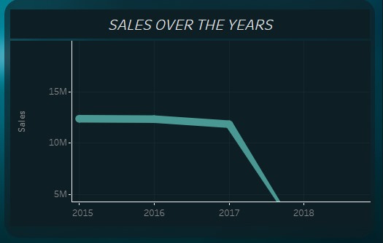
3.sales over the year
The image illustrates sales trends over four years. Sales began to decline gradually after 2015, with a sharp drop in the final year, 2017, leading to a complete absence of sales in 2018. This suggests that the company may have either ceased operations or stopped production due to significant losses.

Slide 16
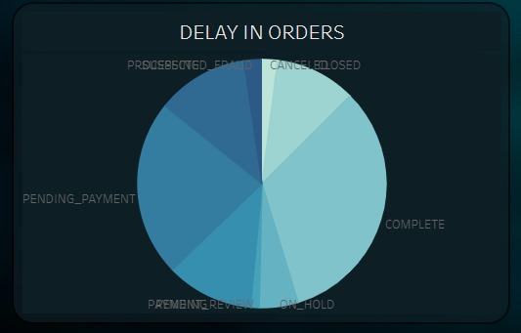
4.Delay in order
The pie chart represents order delays categorized into: "Pending Payment," "Pre-Member Review," "On-Hold," "Complete," and "Cancelled." The exact figures are available using the Tooltip, but based on the visual breakdown, "Complete" and "Pending Payment" appear to be the largest categories, indicating that most orders are either completed or awaiting payment. The "Cancelled" category seems the smallest, suggesting very few cancellations. The "Pre-Member Review" and "On-Hold" categories are relatively medium-sized.

Slide 17
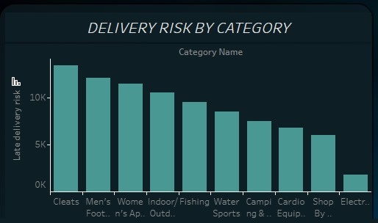
5.Delivery risk by category
The image illustrates the top 10 product categories by profit over the four years of 2015, 2016, 2017, and 2018. However, it’s noticeable that there are no recorded profits in 2018. Additionally, some products are being produced but are not generating any sales, which could lead to losses since they are manufactured but not sold.

Slide 18
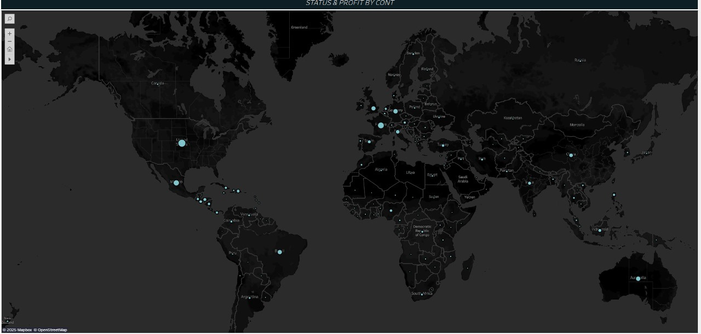
6.Map
The Map shows the locations where orders are placed with the company and also indicates the status of these orders in each city. After review, it was found that fully completed orders constitute the largest proportion. Additionally, delays in orders may be attributed to the geographical distance between the company and the delivery locations.

Slide 19
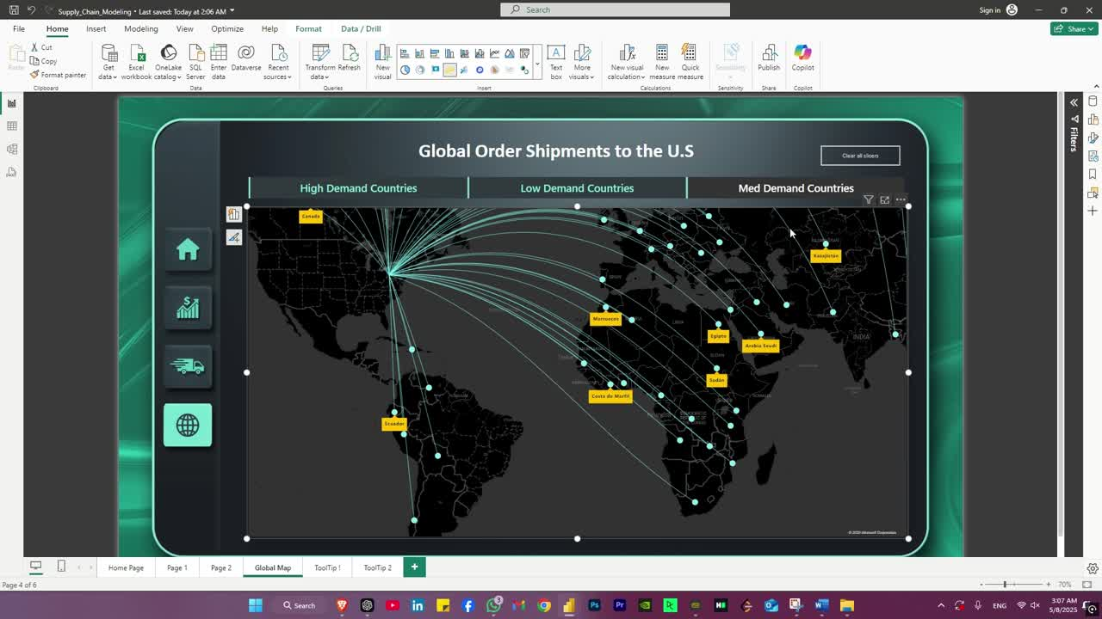
Shipping Routes Map
Added route map that illustrates the shipment routes between countries, with each connection representing a real delivery path from the origin to the destination.
It provides geographic insight into
shipping patterns, highlights high-demand
areas, and supports analysis
of delivery efficiency across regions.
This map is primarily designed to compare
delivery distances between various countries
and classify countries according to
level of transactions

Slide 20

Dashboard demo
1- Creating Dashboard Background
created UI style layouts using Adobe Photoshop to organize the dashboard structure in a clear and consistent way before building it in Power BI. I paid attention to lighting effects to visually highlight key elements and designed
interactive sidebar buttons to
enhance user experience.

Slide 21
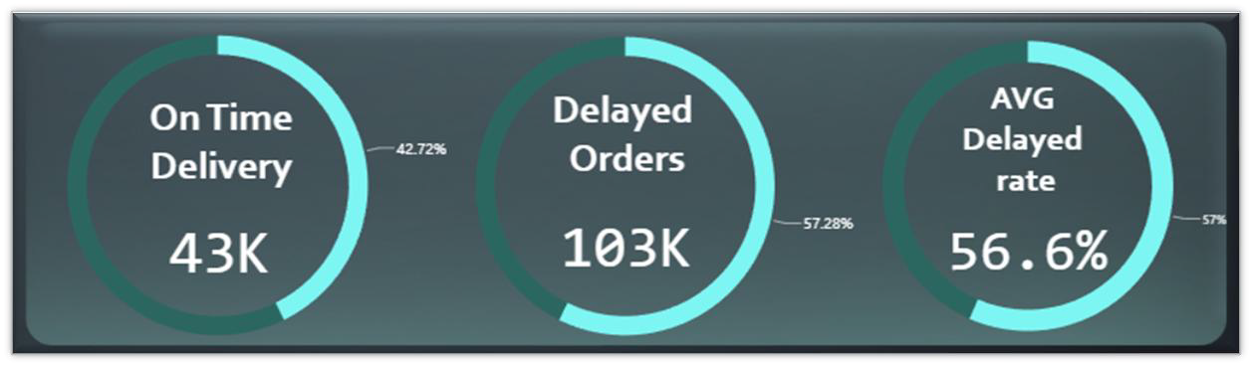
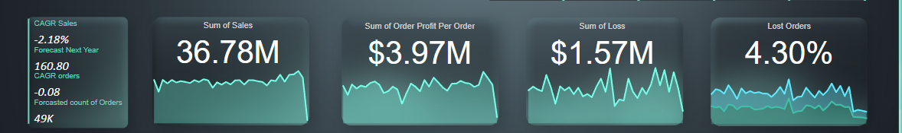
Dashboard demo
2-KPIs
To effectively evaluate the performance of the supply chain, I identified and implemented a set of key performance indicators (KPIs) that reflect the critical aspects of operational efficiency and logistics performance. These include metrics such as:
Compound Annual Growth Rate (CAGR)
Percetage of lost orders
Distribution of lost orders
Avg delay ratio
Percentage of delayed orders
Percentage of on time delivered orders

Slide 22
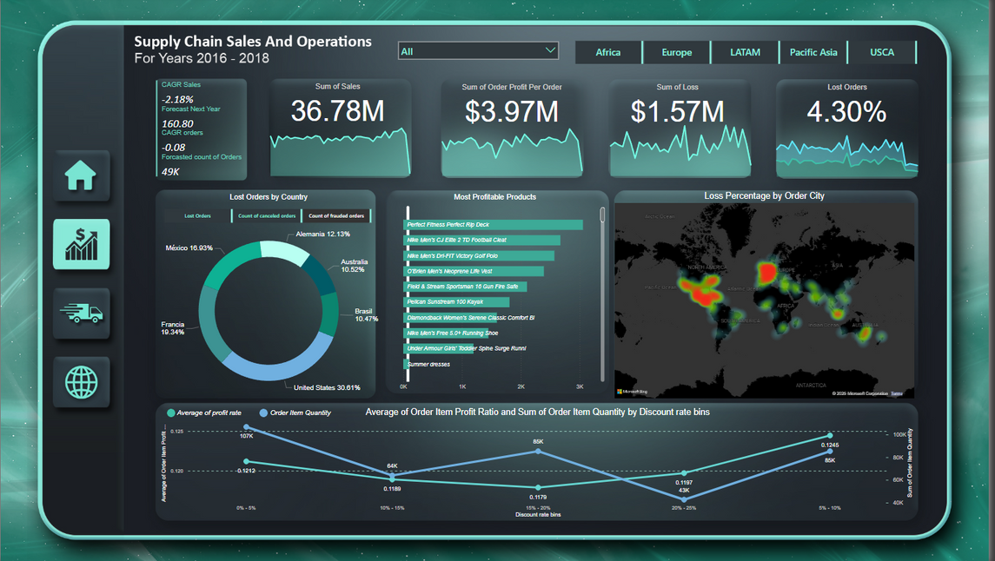
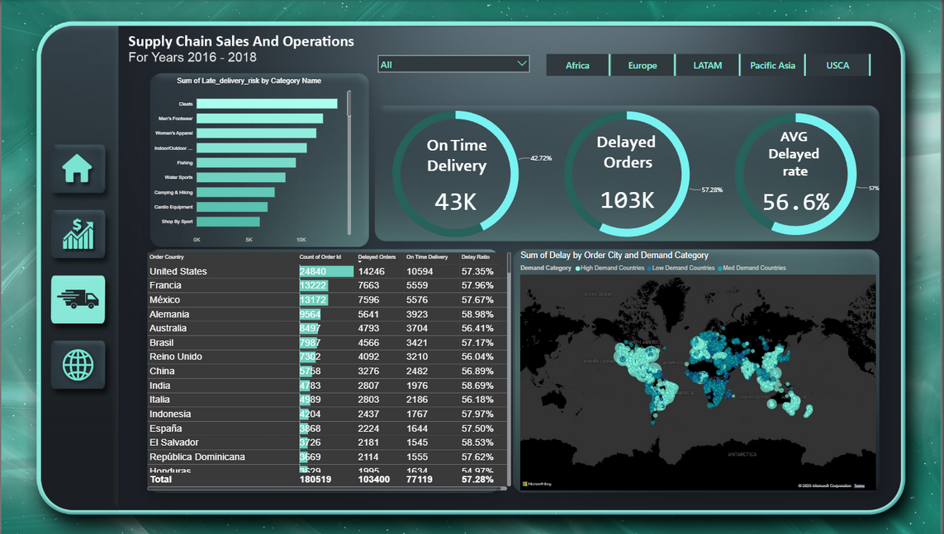
Dashboard Preview

Slide 23
Conclusion
This project showcases how comprehensive data analysis can enhance supply chain management by providing actionable insights into logistics, supplier reliability, and inventory management. Through advanced analytics and interactive visualizations, it uncovers inefficiencies and offers data-driven recommendations that improve agility, minimize risks, and optimize resources. Ultimately, the project demonstrates how modern tools can transform complex supply chain data into strategic knowledge that drives efficiency, resilience, and sustainable growth.

